Slide 1
Sequence Container: vector
Sequence container vector
  Logically: same as arrays
  Processed like arrays
All containers
  Use same names for common operations
  Have specific operations

Slide 2
Sequence Container: vector
Vector container
  Stores, manages objects in a dynamic array
  Elements accessed randomly
  Time-consuming item insertion: middle, beginning
  Fast item insertion: end
Class implementing vector container
  vector
Header file containing the class vector
  vector
Data Structures Using C++ 2E

Slide 3
Sequence Container: vector (cont’d.)
Using a vector container in a program requires the following statement:
  #include <vector>
Defining a vector container object
  Specify object type
  Example: vector<int> intlist;
  Example: vector<string> stringList;
Data Structures Using C++ 2E

Slide 4
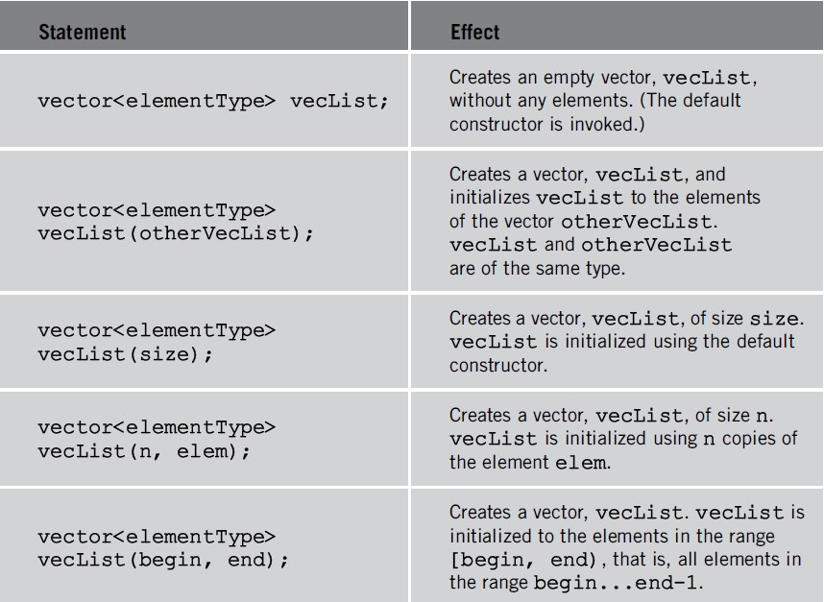
vector constructors
TABLE 4-1 Various ways to declare and initialize
a vector container
Data Structures Using C++ 2E

Slide 5
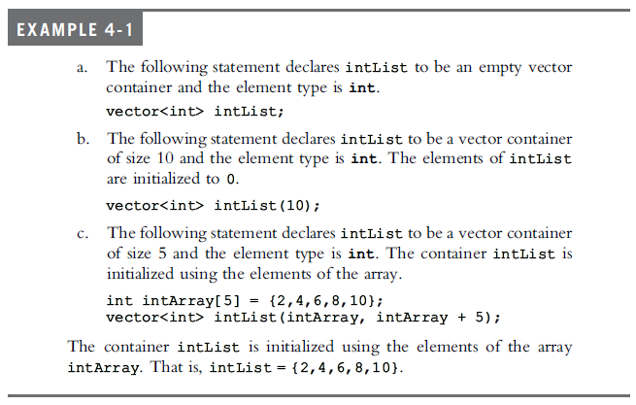
Data Structures Using C++ 2E

Slide 6
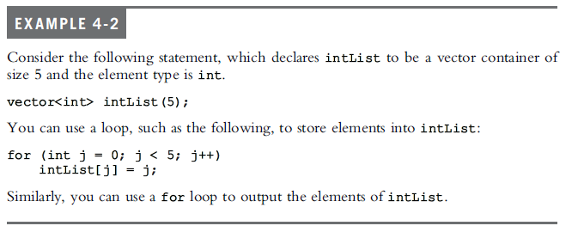
Stepping through the elements of a vector array
Data Structures Using C++ 2E

Slide 7
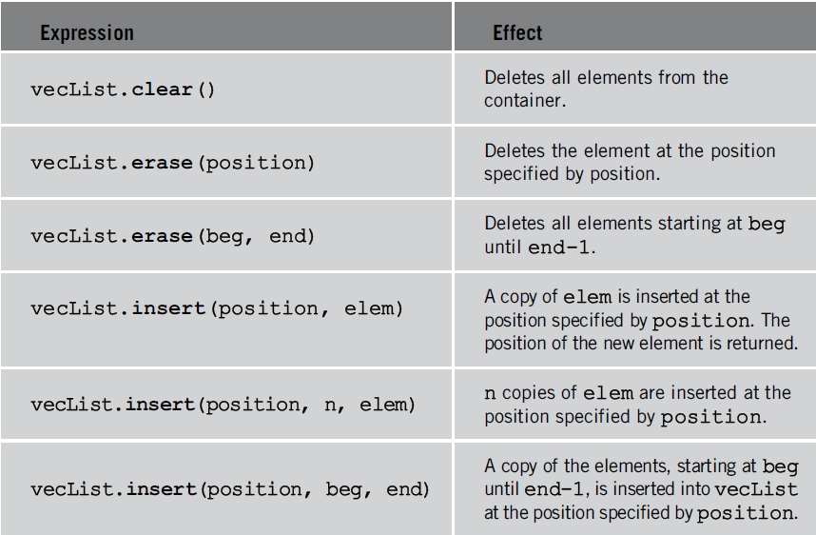
Sequence Container: vector (cont’d.)
TABLE 4-3 Various operations on a vector container
Data Structures Using C++ 2E

Slide 8
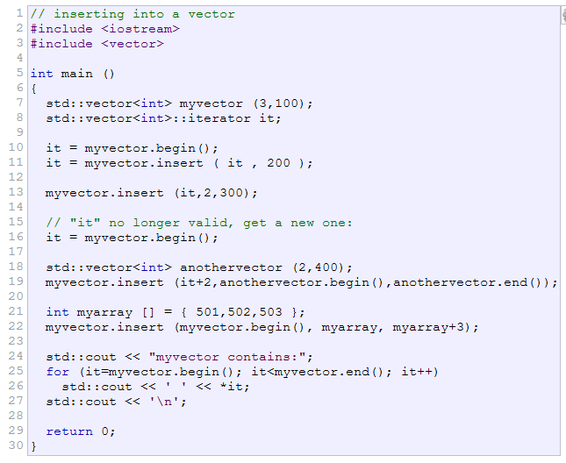

Data Structures Using C++ 2E

Slide 9
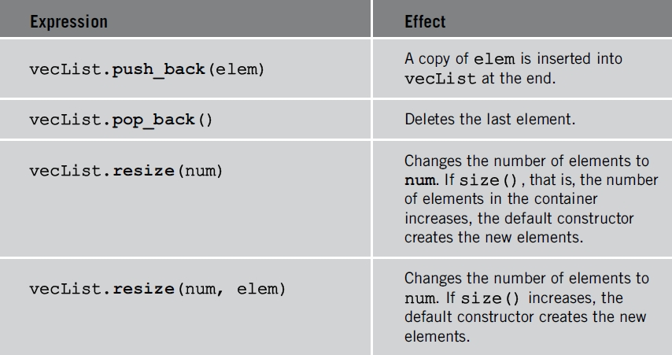
Sequence Container: vector (cont’d.)
TABLE 4-3 Various operations on a vector container (cont’d.)
Data Structures Using C++ 2E

Slide 10
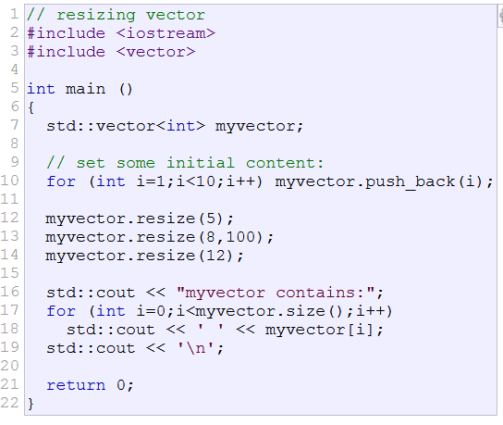

Data Structures Using C++ 2E

Slide 11
Declaring an Iterator to a Vector
Data Structures Using C++ 2E

Slide 12
Declaring an Iterator to a Vector
vector<int>::iterator intVecIter;
++intVecIter
  Advances iterator intVecIter to next element into the container
*intVecIter
  Returns element at current iterator position
Data Structures Using C++ 2E

Slide 13
Containers and the Functions begin and end
begin
  Returns position of the first element into the container
end
  Returns position of the last element into the container
Data Structures Using C++ 2E

Slide 14
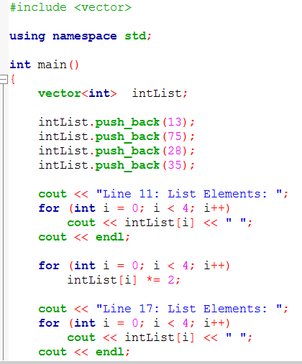
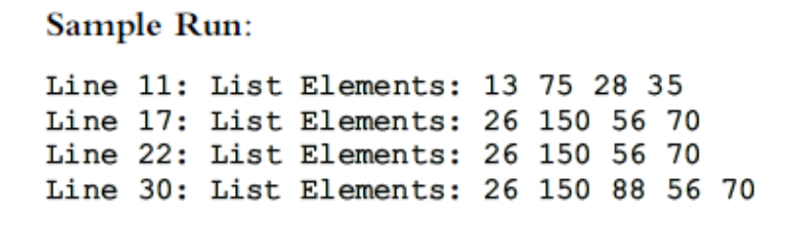
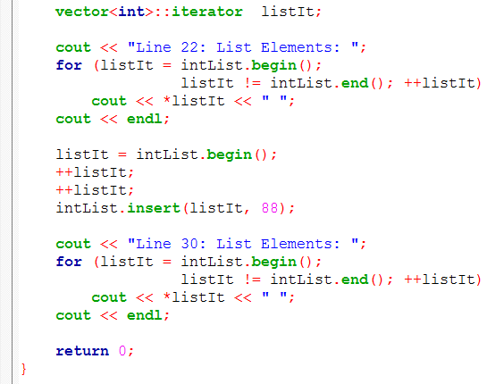
Data Structures Using C++ 2E

Slide 15
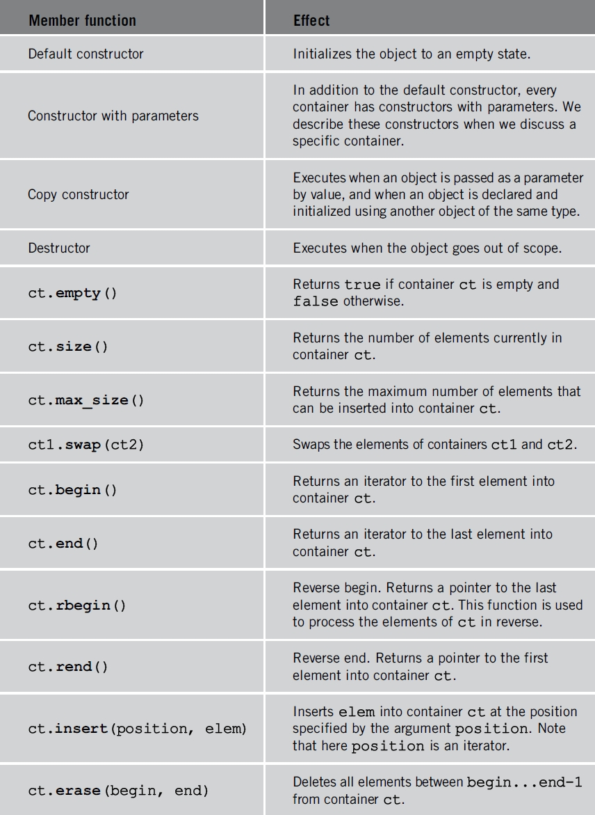
TABLE 4-5 Member functions common to all containers (cont’d.)
Data Structures Using C++ 2E

Slide 16
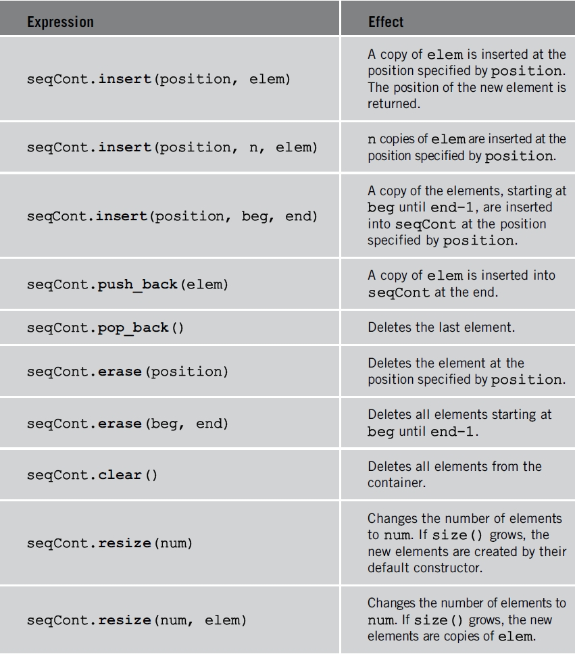
Member Functions Common to Sequence Containers
TABLE 4-6 Member functions common to all sequence containers
Data Structures Using C++ 2E

Slide 17
Analysis vector vs list
Random access
Insertion
Data Structures Using C++ 2E

